Slide 1
‘TheTheatre’
so briefly about the building we’re redesigning

Slide 2
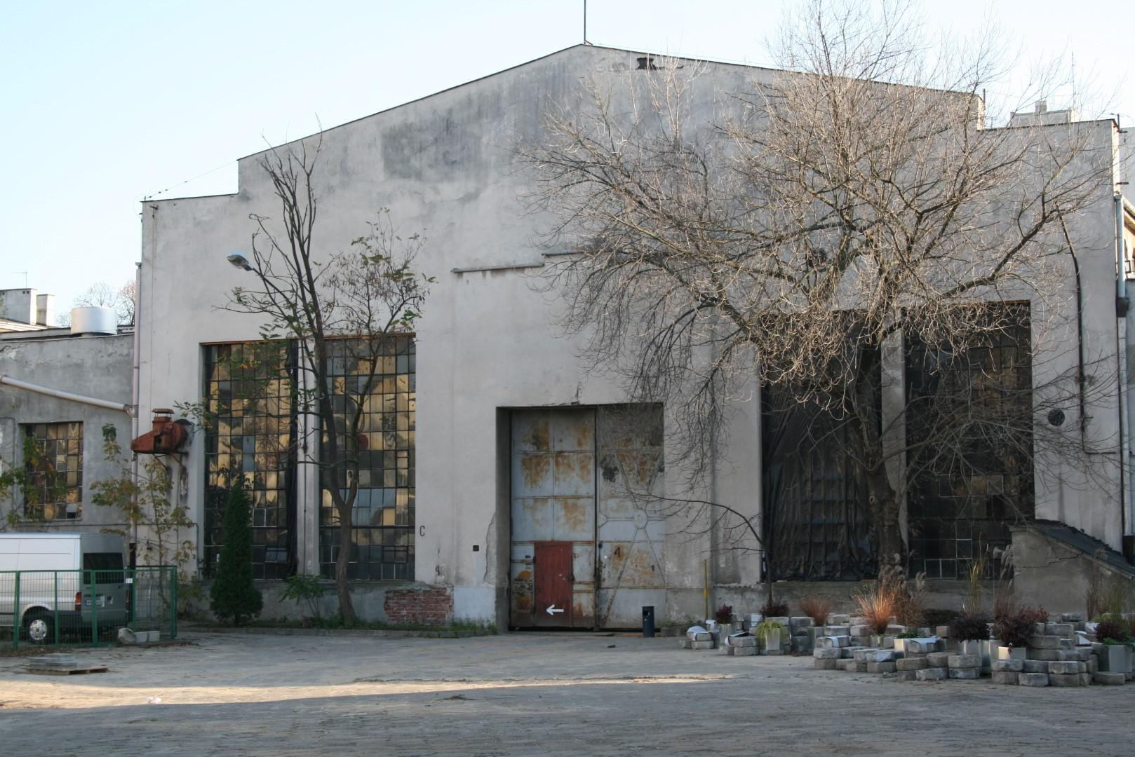
Edifice is a part of a complex of the buildings and it was built in 1927 in order to store trucks.

Slide 3
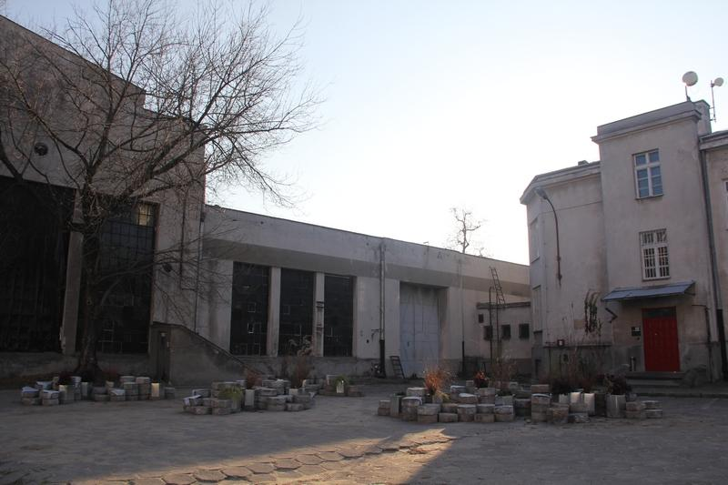
It was used by the Warsaw Rubbish and Waste Removal Company for a long time (Polish abbreviation MPO)

Slide 4
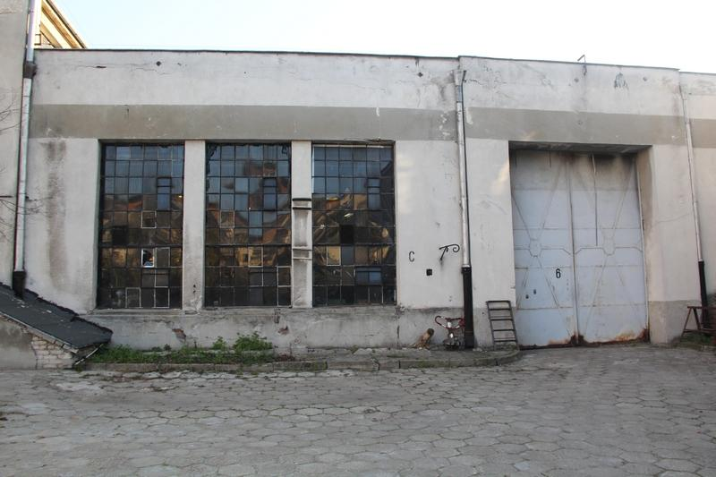
The building was listed in the register of the historical treasures in 2008.

Slide 5
Since 2012 the hall with other buildings of the complex has belonged to the NewTheatre of Krzysztof Warlikowski

Slide 6
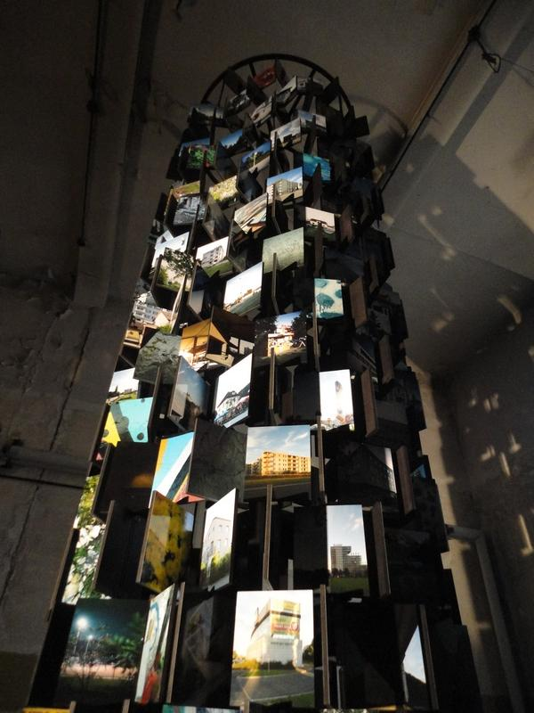
Nowadays the place is used as a stage and a workshop hall,mainly for displays (Oct-Nov 2012- Photography of Warsaw)

Slide 7
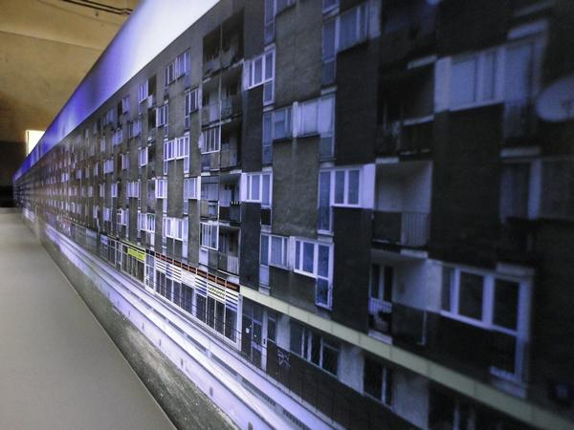
The photography of Warsaw and related practices

Slide 8
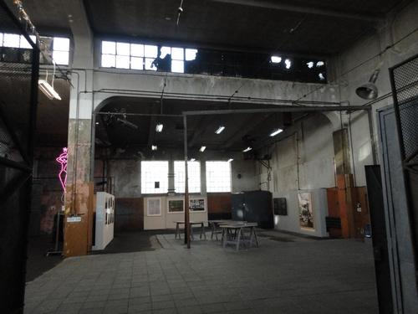
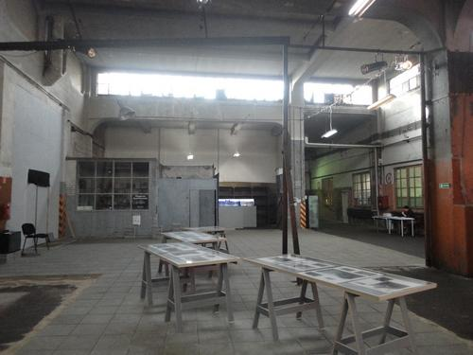
Inside

Slide 9
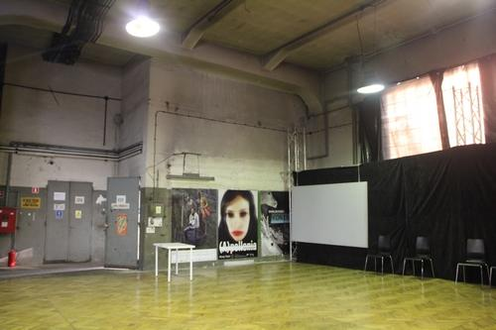
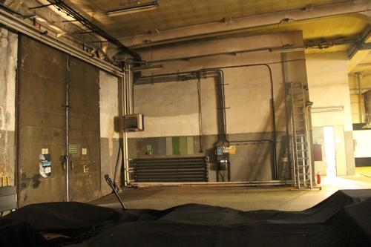

Slide 10
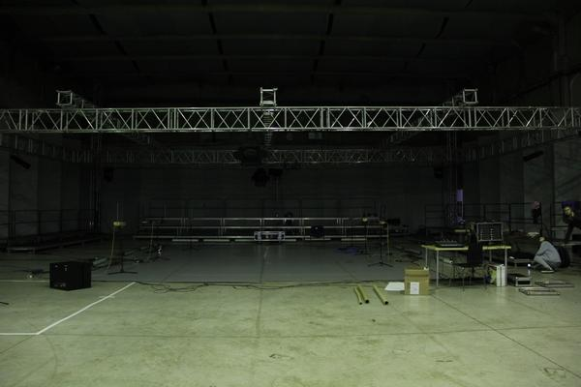
Stage

Slide 11
